Slide 1
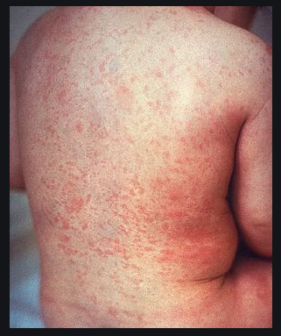
RUBELLA VIRUS
Family: Togaviridae

Slide 2
RUBELLA
Rubella/ German measles is primarily a mild childhood disease.
It may be acquired congenitally or post-natally

Slide 3
Morphology
Roughly spherical
Diameter: 50-70nm
Enveloped RNA virus
It has single stranded RNA genome
Envelop has haemagglutinin peplomer-The virus agglutinates erythrocytes at 4⁰C

Slide 4
Resistance
Destroyed by heating at 56 ⁰C
Inactivated by chemicals such as ether, chloroform, formaldehyde

Slide 5
Pathogenesis
Congenital rubella: virus cross the placenta and replicate in the differentiating cells of the embryo
The fetal cells are not destroyed, but the rate of growth is reduced
It may result in congenital abnormalities or even death of fetus
Congenital rubella syndrome: cataract, deafness and Patent Ductus Arteriosus

Slide 6
Post natal rubella
Infection is acquired by inhalation
The virus multiplies locally and in cervical lymph node
After 2-3 weeks the virus is disseminated through out the body by blood stream
Patient develops fever, fine, pink macular rashes- which first appears on the face and then spreads to the trunk

Slide 7
Laboratory diagnosis
1. Virus isolation:
Specimen: throat swab
The specimen is inoculated in rabbit kidney
Immunofluorescence is used for viral antigen detection
2. Serological diagnosis:
Antibodies in blood are detected by ELISA
In newborn rubella specific IgM antibody is diagnostic of congenital rubella
Other tests are latex agglutination, immunofluorescence assay

Slide 8
Prophylaxis
Live attenuated vaccine: administered subcutaneously
MMR: for all infants at the age of 15 months followed by booster dose at 4-6 years
In women avoid pregnancy for 3 months after vaccination

